Slide 1
Microsoft Fabric Time to Git CI/CD
Kristyna Ferris
She/Her
Solution Architect
P3 Adaptive

Slide 2



Kristyna
Ferris
Microsoft MVP, Data Platform & Fabric Solution Architect, P3 Adaptive Lexington Data Tech Group co-organizer Co-author on DataOnWheels Co-founder of Data On Rails
@data_dragoness
https://www.linkedin.com/in/kristyna-ferris-dataonwheels/
https://dataonwheels.wordpress.com/
Notes:
Peter

Slide 3

Overview
Git integration: side-by-side development, code reviews, and change tracking.
Deployment Pipelines: development > testing > production.
Limitations & Eccentric “Features: things that don’t quite work yet and how to work around them.
Notes:
CI/CD workflow options in Fabric - Microsoft Fabric | Microsoft Learn

Slide 4

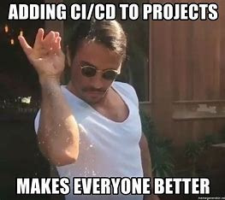
What is Git?
Source control management
Enables collaboration
Captures version history
Continuous integration and continuous delivery (CI/CD)
Notes:
CI/CD workflow options in Fabric - Microsoft Fabric | Microsoft Learn

Slide 5
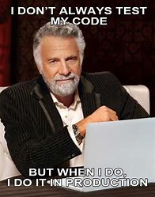
Why do we need CI/CD?
Notes:
CI/CD workflow options in Fabric - Microsoft Fabric | Microsoft Learn

Slide 6

Code for Future You
Unfortunately, nobody is perfect.
Stakeholders change their minds.
Continuous delivery – for your stakeholders.
Co-development – for your development teams.
Notes:
CI/CD workflow options in Fabric - Microsoft Fabric | Microsoft Learn
The power of CI/CD lies within the ability to make a copy of your code (or report) to develop and test against while your stakeholders interact with the current version.
Using git also enables multiple developers to work on the same project at the same time.

Slide 7
Key Git Concepts
Branch - copy of code where individuals make changes and run tests against code.
Check out - creates a new branch based on a specified branch.
Stage - select what changes you would like to apply to main.
Commit - send staged changes up to the remote branch.
Pull Request - process for peer review before code is merged back to the main branch.
Merge - grabs all the pieces of code from the branch and adds them to main.
Notes:
CI/CD workflow options in Fabric - Microsoft Fabric | Microsoft Learn

Slide 8
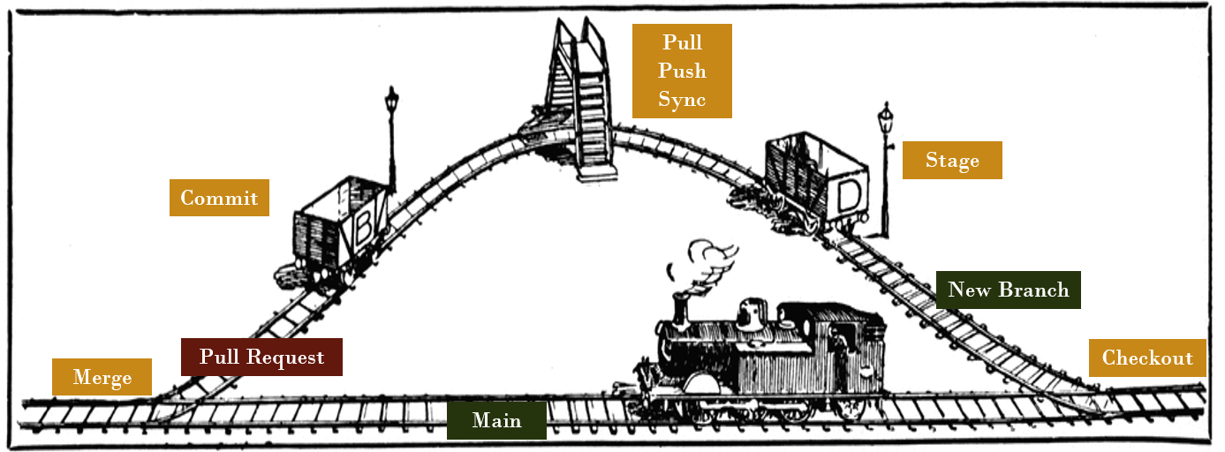
Git Station
Notes:
CI/CD workflow options in Fabric - Microsoft Fabric | Microsoft Learn

Slide 9
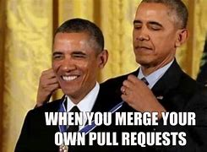
Do I really NEED Pull Requests (PRs)?
PR is short-hand for Pull Request.
PRs allow for a final approval round before merging your code back into the main branch.
Allows for better coding standard maintenance and accountability.

Slide 10
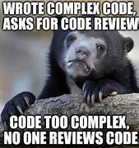
PR Etiquette
Make sure your code uses clear variables and naming conventions.
Commit often and write clear commit messages.
Put notes into your code to help future you and current reviewers.

Slide 11
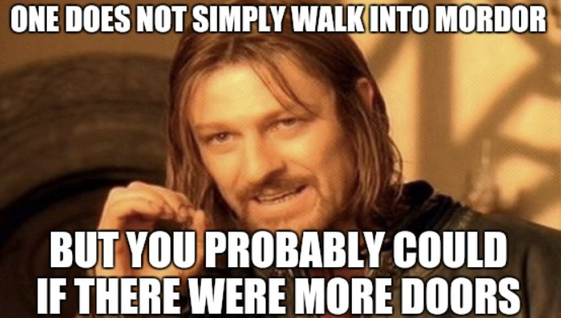
One does not simply review a PBIP
PBIP = Power BI Project file
PBIPs make it possible for us to source control Power BI Reports and Semantic Models
Reviewing a PBIP in DevOps requires an ability to visualize JSON as an object

Slide 12
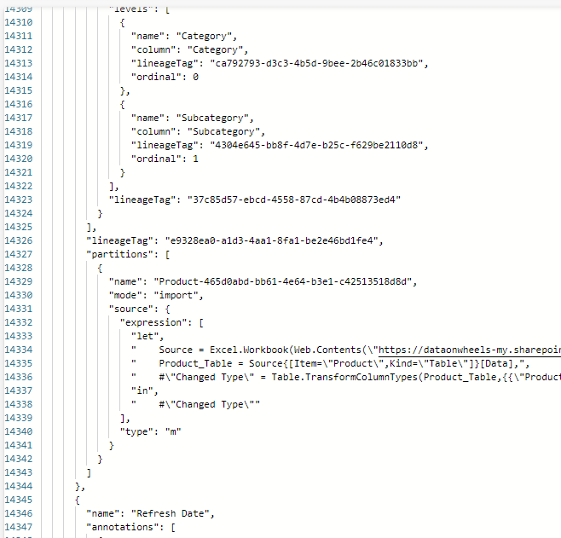
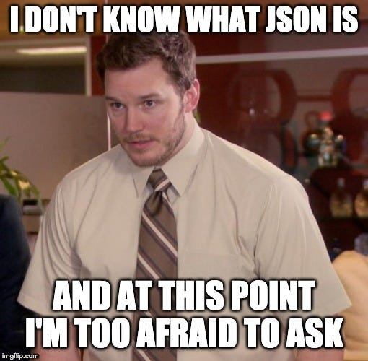
PBIP PRs

Slide 13


Unconventional Use of Deployment Pipelines
DevOps isn’t quite the tool we are looking for to review Power BI report changes.
Fabric deployment pipelines can offer us a better way to review visual changes to a report.
Still add notes into the PR itself to help the review process.

Slide 14

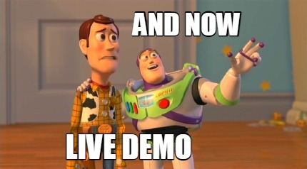
Demo Time!
Notes:
Walking through how to connect an existing workspace to an Azure DevOps repo, sync to local machine, make changes, and merge those back to the workspace.

Slide 15

Limitations
A lot of items are in preview, Notebooks are the only supported item not in preview.
Preview
Data pipelines
Lakehouse
Paginated Reports
Power BI Reports
Semantic Models
Spark Job Definitions
Unsupported
AI Skill
Apache Airflow Job
API for GraphQL
Dashboard
Dataflow Gen 1 & 2
Datamart
Eventhouse
Spark Environment
Warehouse
Eventstream
Mirrored Databases
ML Models
Reflex
Scorecard

Slide 16
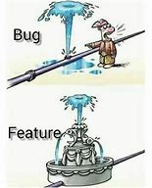
Eccentric Bugs & Features - 1
Syncing from a workspace or to a workspace will often return errors.

Slide 17
Eccentric “Features” - 1
Syncing from a workspace or to a workspace will often return errors.
Work Around: refresh browser or log out then back in.

Slide 18
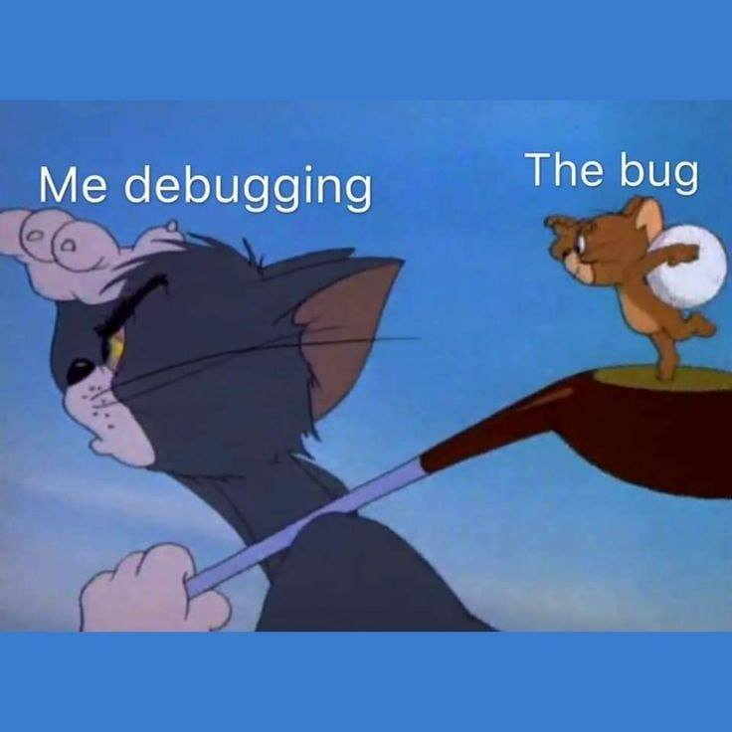
Eccentric “Features” - 2
Before doing a PR into the branch your workspace is based on, you must make sure that item has no changes in the workspace that need to be pushed to the repo.

Slide 19
Eccentric “Features” - 2
Before doing a PR into the branch your workspace is based on, you must make sure that item has no changes in the workspace that need to be pushed to the repo.
Work Around: revert change in PR, pull in the changes from the workspace, then redo the PR and sync into the workspace.

Slide 20
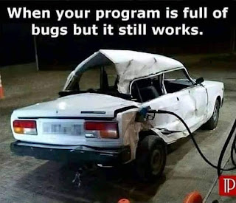
Eccentric “Features”
Occasionally, pulling in changes doesn’t work at all.

Slide 21
Eccentric “Features”
Occasionally, pulling in changes doesn’t work at all.
Work Around (?): bypass the repo process and make the change directly in the workspace Fabric item. Annoying, but it must be done.

Slide 22


Slide 23

Git Hub Link
@data_dragoness
https://www.linkedin.com/in/kristyna-ferris-dataonwheels/
https://dataonwheels.wordpress.com/

Slide 24
































































Icons
*For stats and description content only, do not include in master slides and layouts

Slide 25




Using the icons
The icons can be used big or small.
Please avoid overlapping or distorting the icons.
They can be used as bullet points
Just like they’re being used here
Keep them relevant to the point if possible

Slide 26



Logos and other icons

